Slide 1

Phone Book Management System
Supervised by:
Khan Md. Hasib
Lecturer,
CSE Department
State University of Bangladesh
Presented by:
Name: Yeasmin Akter
ID: UG02-48-18-013

Slide 2
Outline:
Technologies Used.
Introduction.
Most Objective Of this Project.
Proposed Methodology.
About My Project.
Learning Of My Project.
Result and Discussion.
Conclusion.
Future Work of My Project.

Slide 3
Technologies Used:
HTML
CSS
Bootstrap
PHP
Database
Sublime Text
XAMPP

Slide 4
Introduction to Phone
Book Management System:
Phone Book is a project that is enables users to easily store and find contact information , such as name, Address ,phone number etc. This technical assignment help to us in that we get a simple SQL, html, Database based solution to store our contact. It will help user to easily Search and manage contact ,email using this system.
The objective of my project phone Book is to record the details various activities of user. The user of the directory will only have the Authority to search any Particular record and listing details of all available records.

Slide 5
Most objective of this project are Following:
First speed Data Processing.
To record the details various activities of user.
The system is very User friendly.
Easily accessed By administrators , Students , Applicants.
Initialization of project is setup in such a way that multiple number of administrator users can access it with name and password.
All contacts and its information is saved in database in the parent Directory.

Slide 6
Project Methodology:
The program will be created the help of Database , Php, Html, Bootstrap. This project can be developed via use of Database Structure. Under this project all the functionality has been added to meet the user's requirements in just few seconds. To provide the desired result on time, it is also using with SQL servers.
If users will make any mistake while entering, they will be given a warning along with correction, which is required to be made.

Slide 7
About My Project Now:
It is a Multiple Administrative Program.
Administrative requires a name, contact number , email , address to access their account.
After execution the Login screen Appears. After login successfully you reach Registration Screen. In this main screen Contact Details are available where options of Add contact, view contact , Delete contact, Update ,email, address, phone number are available.

Slide 8
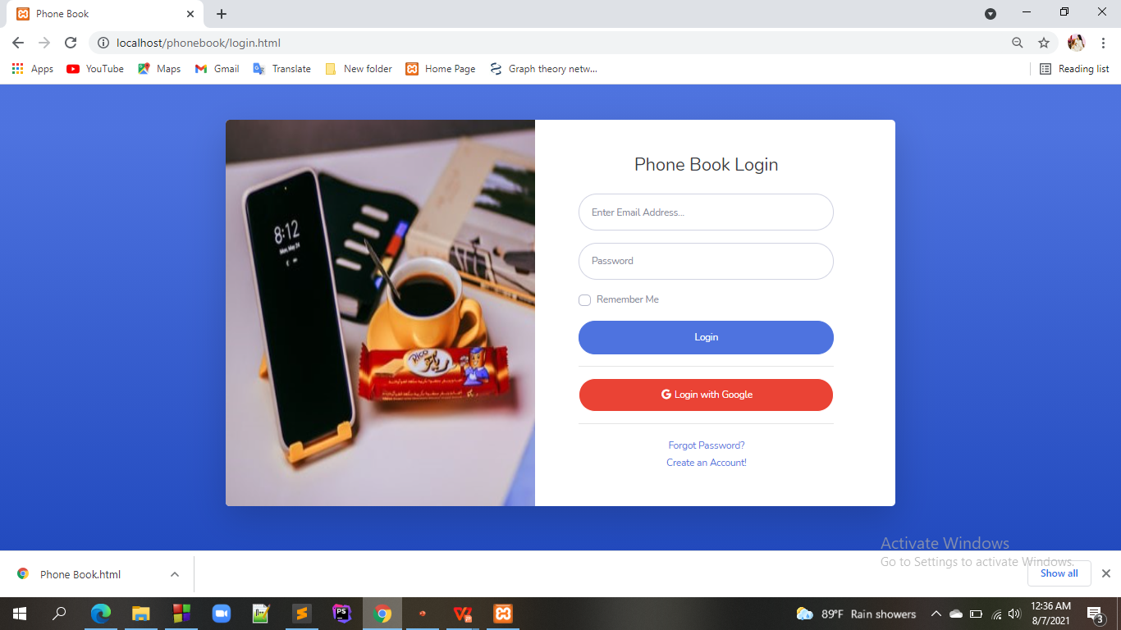

Slide 9
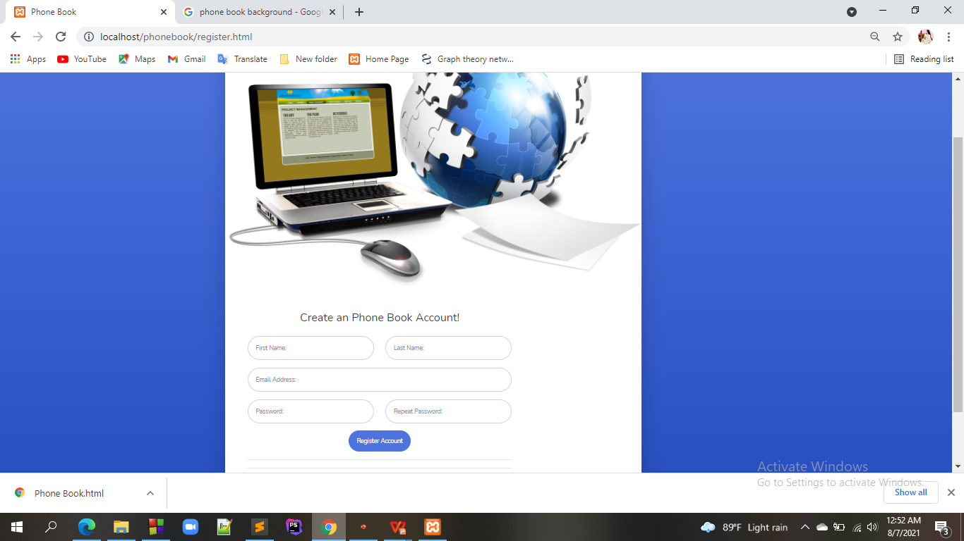

Slide 10
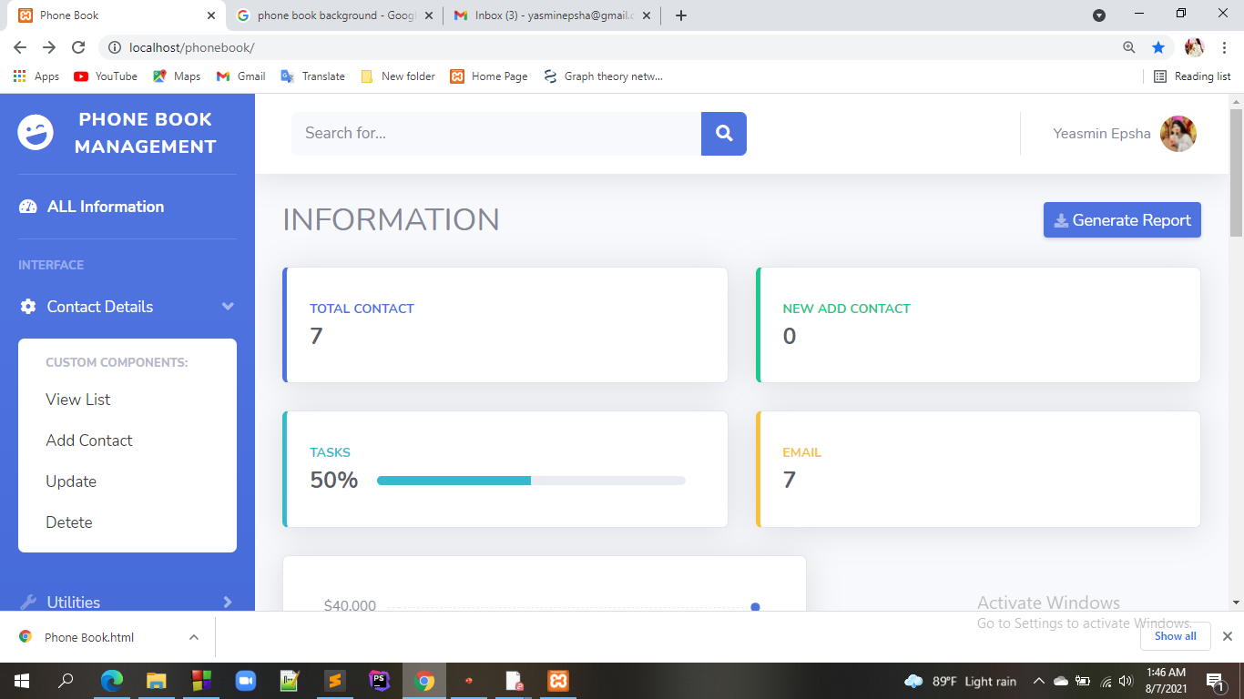

Slide 11
Learning From Project:
Learning Which I develop from this Project is:
Basics of File handling.
Many statements and codes are predefined Functions Which I had not used before are practically used in this project which help me to study them in detail.
I had learned is how to restrict the users throughout the program in different areas of input.

Slide 12
Results And Discussion:
phone Book is a project that is provide by technical assignment help to us in that we get a simple Database solution to store our contacts. We can use it to replace our hard phonebook or even use it as an office wide phone directory. It is not only contains local codes but also ISD codes. The names are present in user-sated formats like alphabetical order. So that user also can easily find the required person along with their address and contact number are use search option. This system is developed using the general need required by the user while using the phone directory. The users of the directory will only have the authority to search any particular record and listing details of all available records. The background processing system will take care of all processing task and maintain data integrity in order to reduce the redundancy of data.
For searching operations, users will able to get any particular record using their contact or email, address but the only condition is that, customers record must be available within the file system.

Slide 13
Conclusion:-
The aim of this project was to build an phone directory through which allowed to search Name, contact Number ,Address , Email of individual and access to PHp SQL Database.
This project will help user to easily search and manage contacts using this system.
This Photo by Unknown author is licensed under CC BY-NC.

Slide 14
FUTURE WORK OF MY PROJECT:-
It is not possible to develop a system that makes all the requirements of the users. User requirement keep changing as system is being used . Some of the Future enhancements that can be done of this system are:
It is possible to upgrade the system and can be online.
Because it is based on SQL , any further changes can be easily adaptable.
Online with OFFLINE mode.

Slide 15


